Slide 1
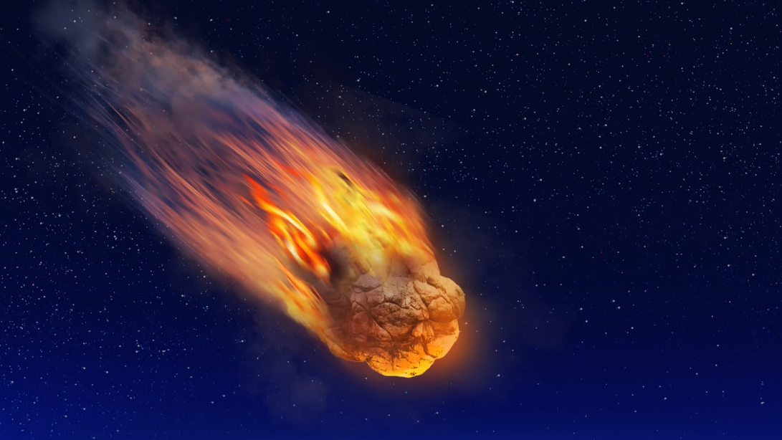
Meteor Madness
Random Access Memories presents...

Slide 2
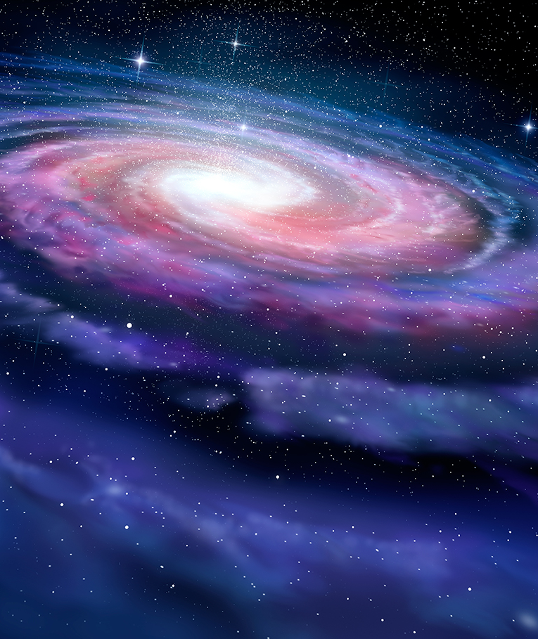
Introduction
VR Application made in Unity.
Throw asteroids at the Earth and see the damage they would cause.
Detailed data pulled from official NASA API.
Real near-miss asteroids.
User-Friendly VR interface.

Slide 3
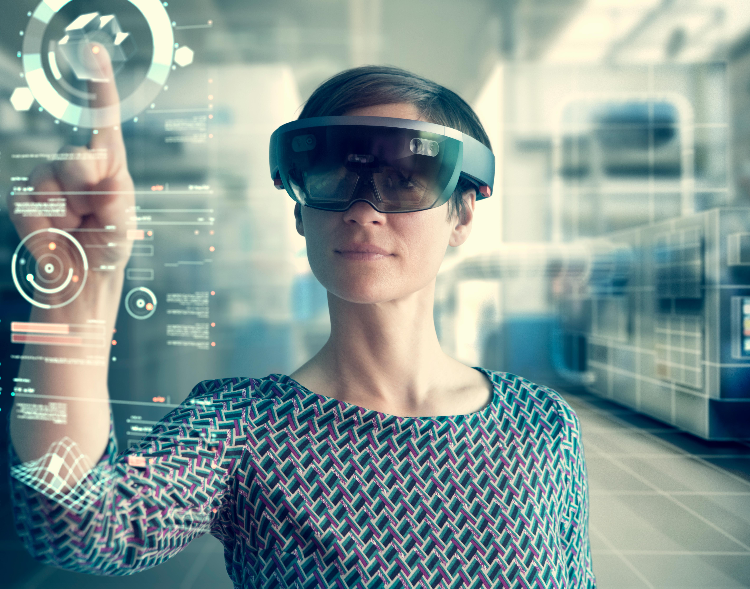
User Movement And interface
User can move around the Earth using point to teleport or the movement stick.
User can open a list of each asteroid in close proximity to Earth, and teleport to them to pick them up.
User can then teleport back to Earth and throw the asteroid in their hands at the planet.

Slide 4
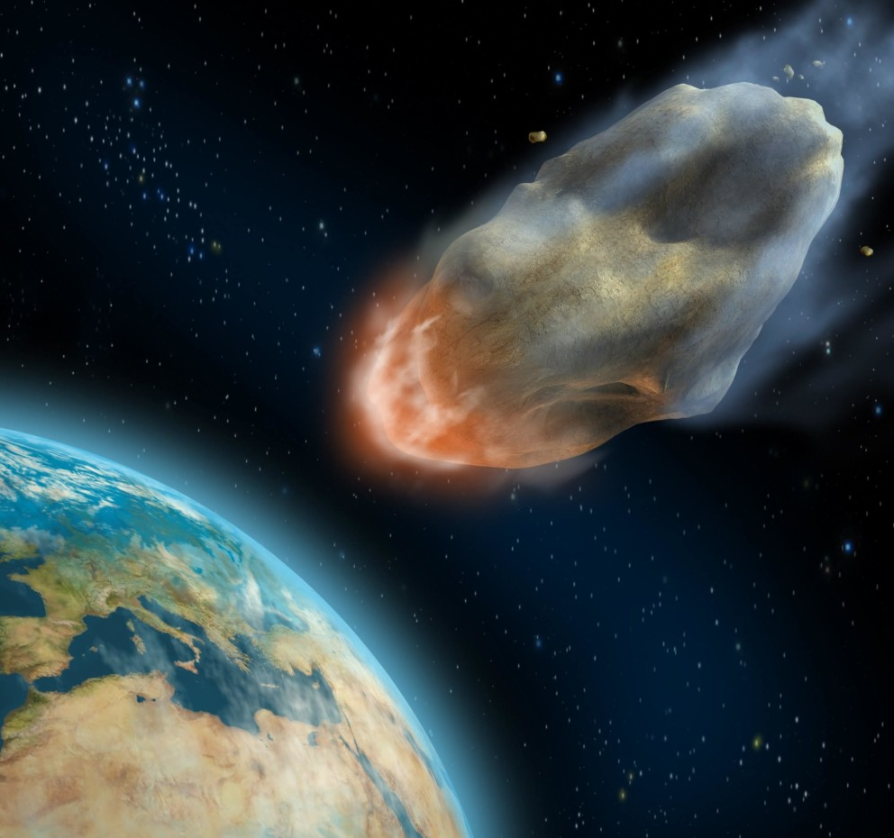
Asteroids
Asteroids Pull data from official NASA API such as mass, speed and size.
These values are then applied to each asteroid.
Asteroids are placed in their correct positions near to Earth.

Slide 5
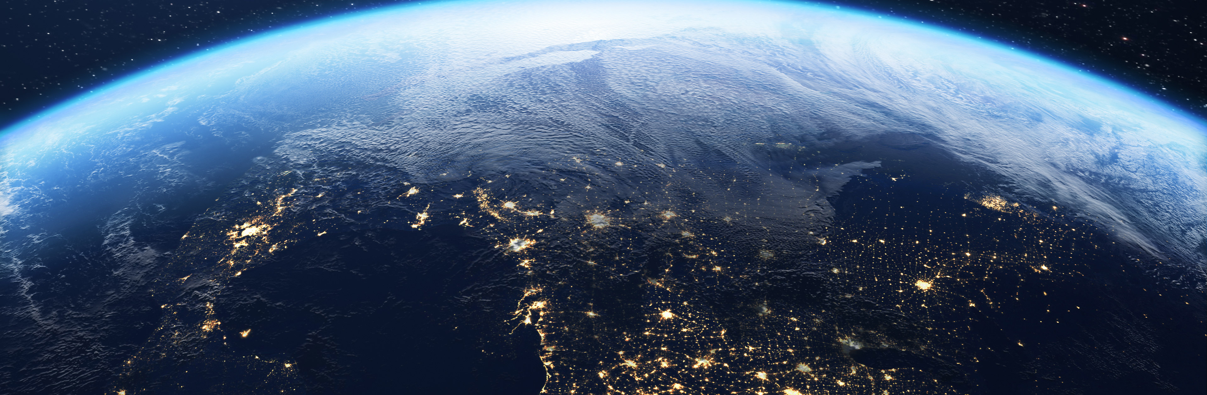
Earth
User can see calculated casualties from specific meteor impacts.
Area of devastation shown to user with easy to understand UI.
Shockwaves are simulated and change depending on meteor mass and speed.

Slide 6
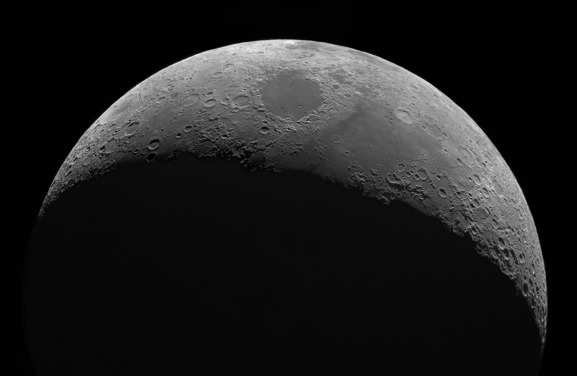
Conclusion
Thank you for listening to our presentation!
Project by Carl, Sam, Eabha, Jack and Evan.

